Slide 1
The NFL COMBINE
Exploring NFL draft and combine data from 1999-2014
Presented By Zachary Clarke

Slide 2
Table of Contents
The NFL Draft
What is the NFL Combine?
The Importance of the Combine
Conclusion

Slide 3
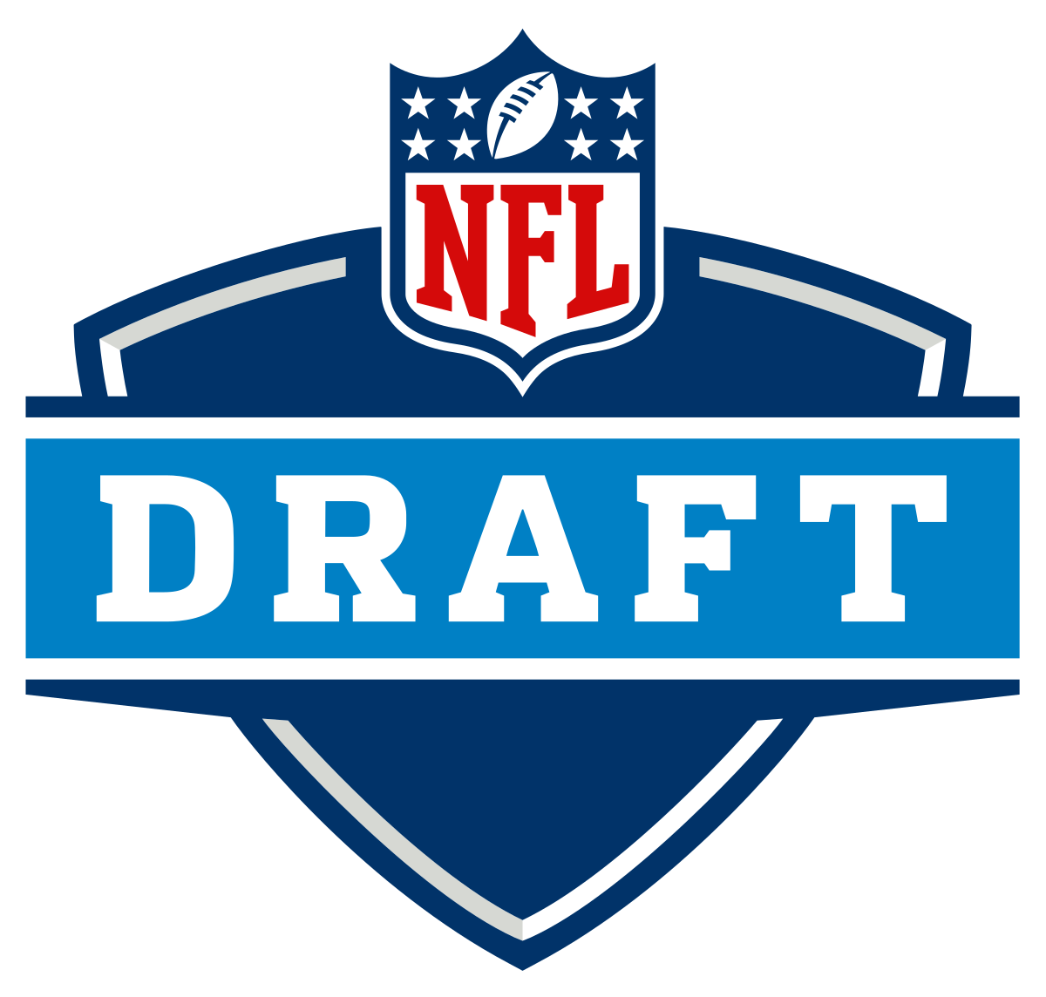
NFL Draft Quick Facts
The NFL Draft is an annual event which serves as the league's most common source of player recruitment. Most if not all the players come from a college football program.
Teams are positioned in the drafting order in reverse order relative to its record in the previous year. Therefor, the team with the worst record choose first and the team that wins the Super Bowl chooses last.
There are 7 total rounds and each team gets one selection in each round.
Typically teams look for…
Starting Players in Rounds: 1-2
Quality Backups in Rounds: 3-4
Fringe Roster players in Rounds: 5-7

Slide 4
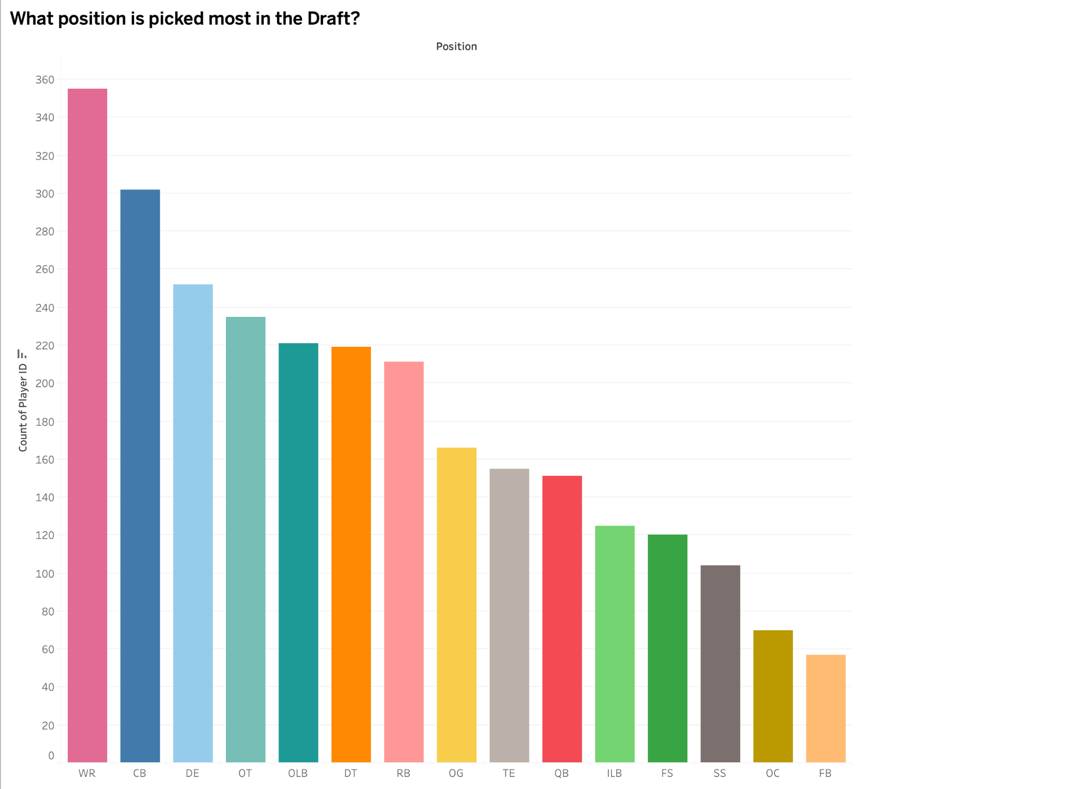

Slide 5
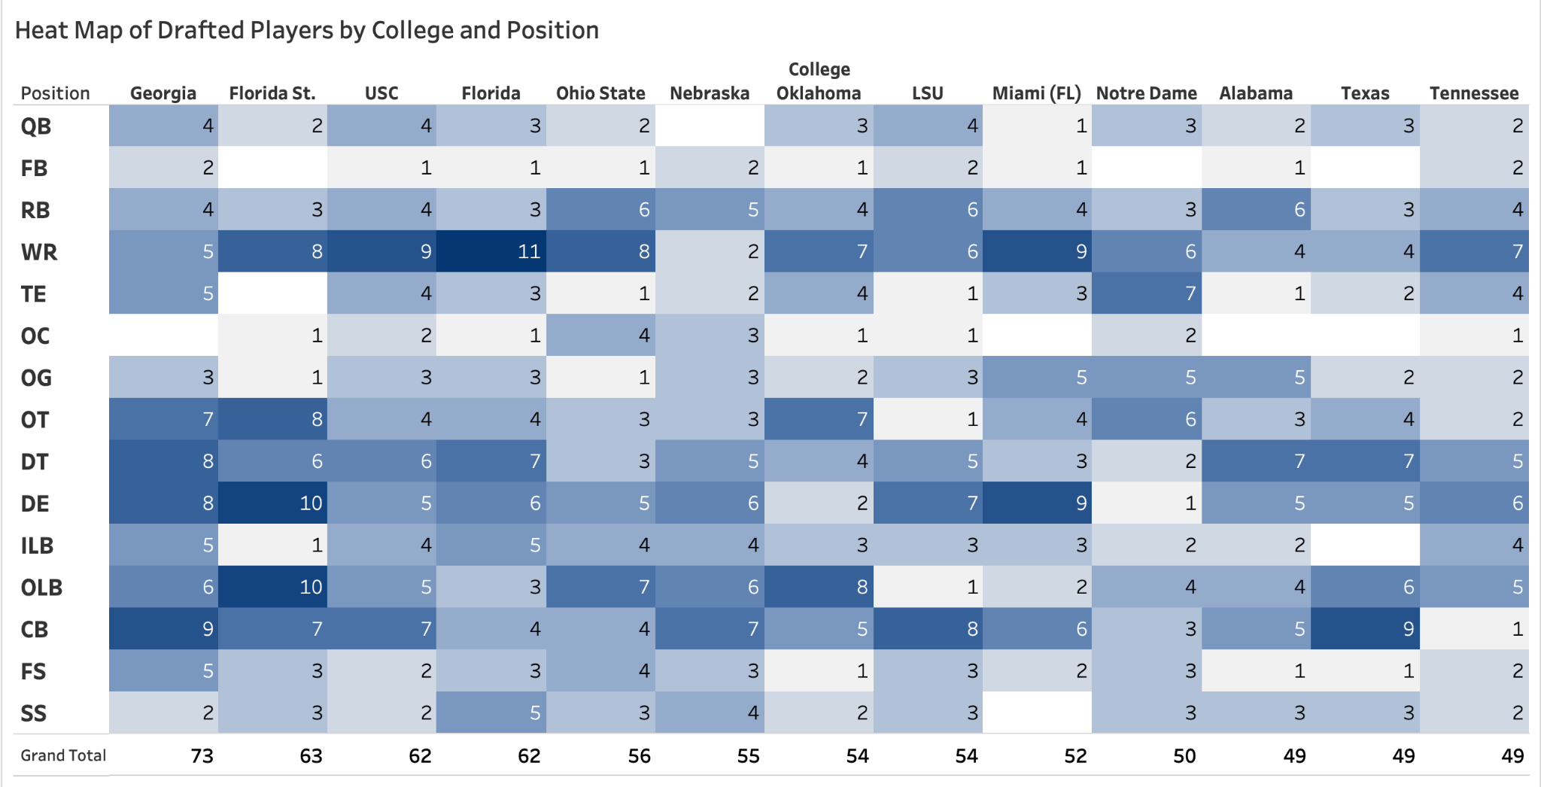
Notes:
During the timeframe of 1999-2014…

Slide 6
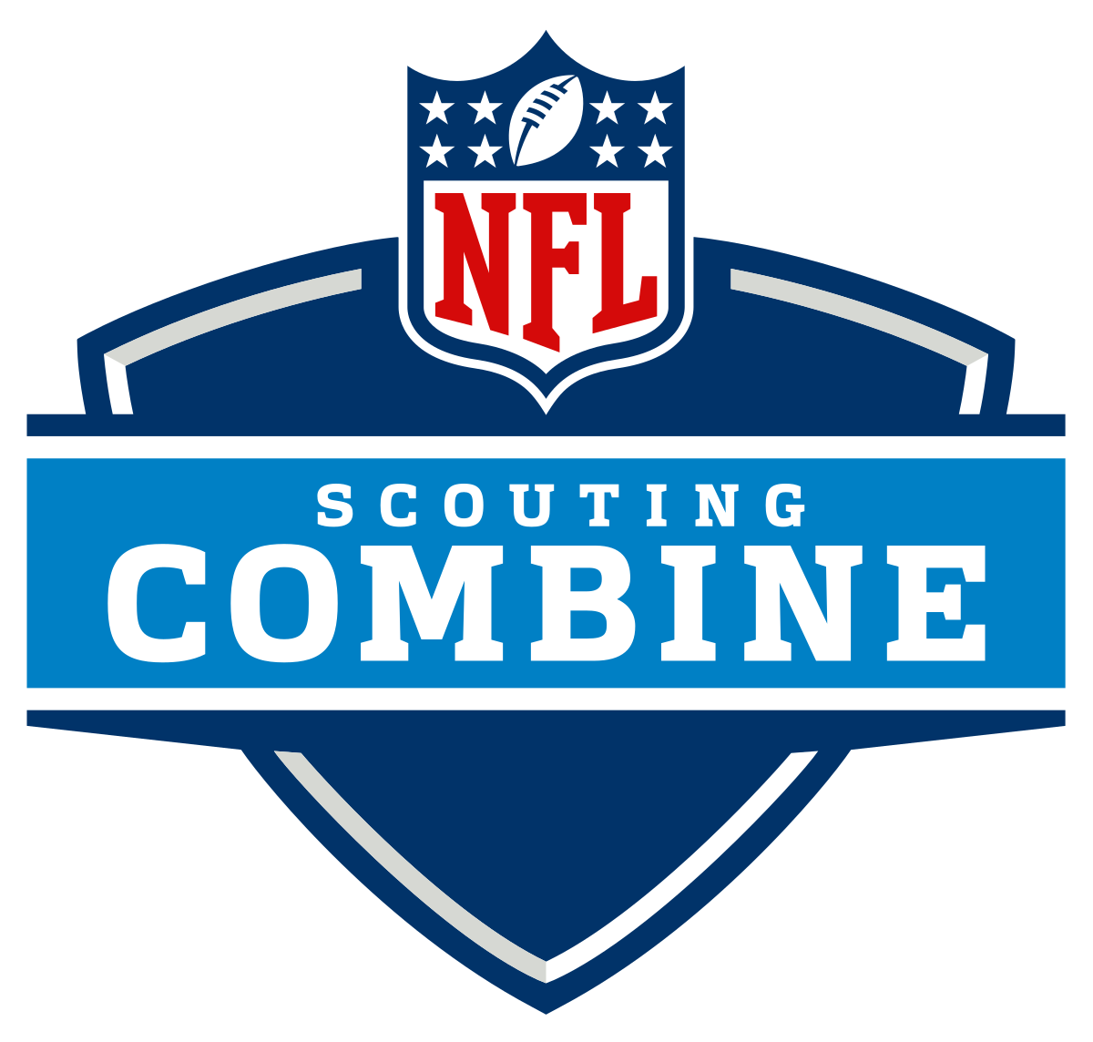
What is the Combine?
The NFL Scouting Combine is a week-long showcase where college football players perform physical and mental tests in front of National Football League coaches, general managers, and scouts.
COMBINE DRILLS
40 - Yard Dash
3 - Cone Drill
20 - Yard Shuttle
Bench Press
Vertical Jump
Broad Jump
PRE - DRAFT MEASUREMENTS
Height
Weight
Arm Length
Hand Size
Notes:
The NFL Scouting Combine is a week-long showcase occurring every February at Lucas Oil Stadium (and formerly at the RCA Dome until 2008) in Indianapolis, where college football players perform physical and mental tests in front of National Football League coaches, general managers, and scouts.

Slide 7
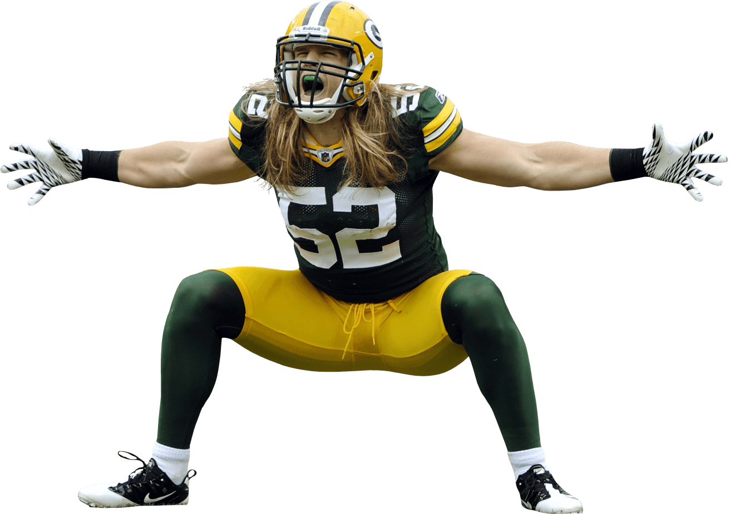
What does the average draftee look like?
Pre-Draft Measurements
Average Height in Inches: 74.2
Average Hand Size in Inches: 9.6
Average Arm Length in Inches: 32.6
Average Weight in Pounds: 249.5
Notes:
*hand size is the length of the thumb to the pinky
Average Male Height is 67 inches.
Average Male hand size is 7.44 inches
Average male arm length is 25 inches
Average American Male is around 200 pounds

Slide 8
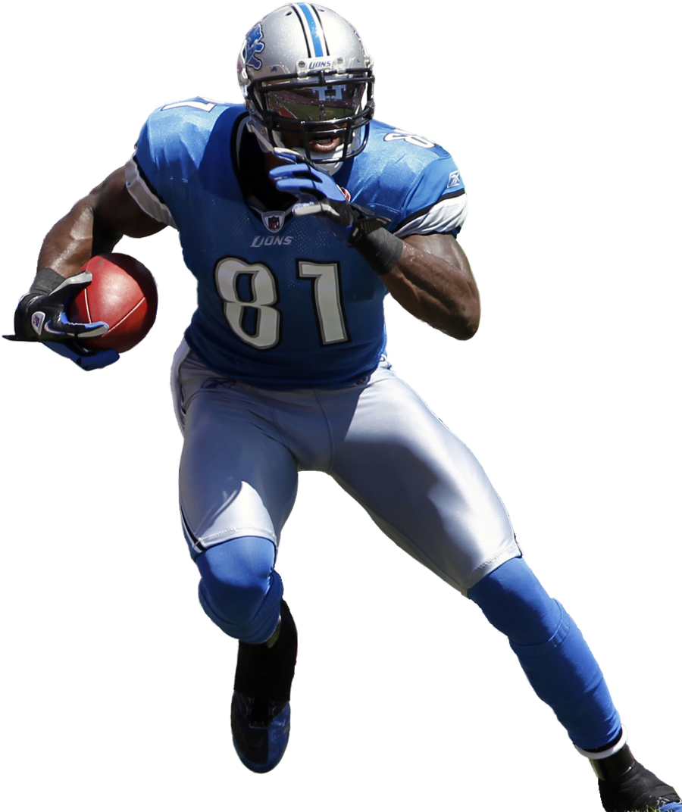
What does the average draftee look like?
Combine Results
Average Bench Press Reps of 225 Lbs: 21.81
Average Vertical Jump in Inches: 32.95 inches
Average Broad Jump in Inches: 113.18
20 - Yard Shuttle in Seconds: 4.4
Average 3 - Cone Drill in Seconds: 7.2
Average 40 - Yard Dash in Seconds: 4.8

Slide 9
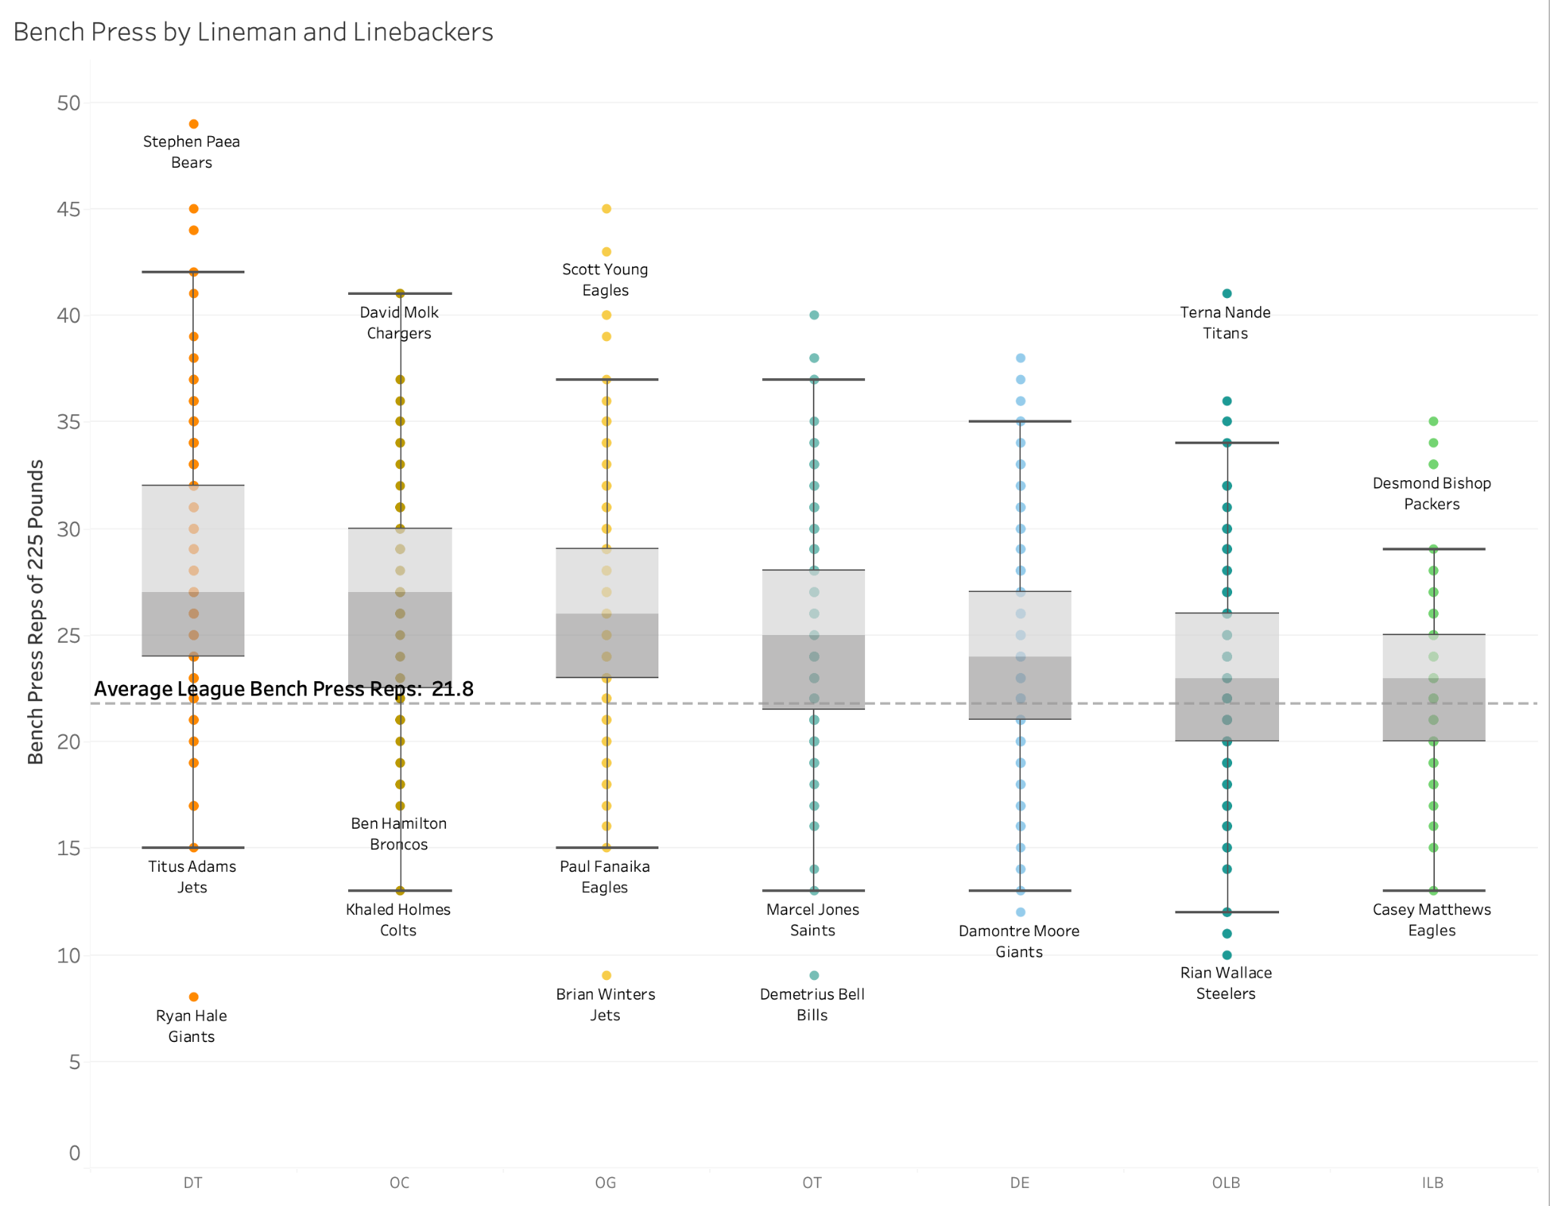
Bench Press Among Lineman and Defensive Players
Notes:
I wanted single out the bench press as a combine drill since it’s a measure of strength.
Defensive and Offensive lineman are the ones who are meant to be stronger.
Interquartile range is higher than the league average.
When it starts falling back down to the mean the players are relying on a combination of speed and strength.

Slide 10
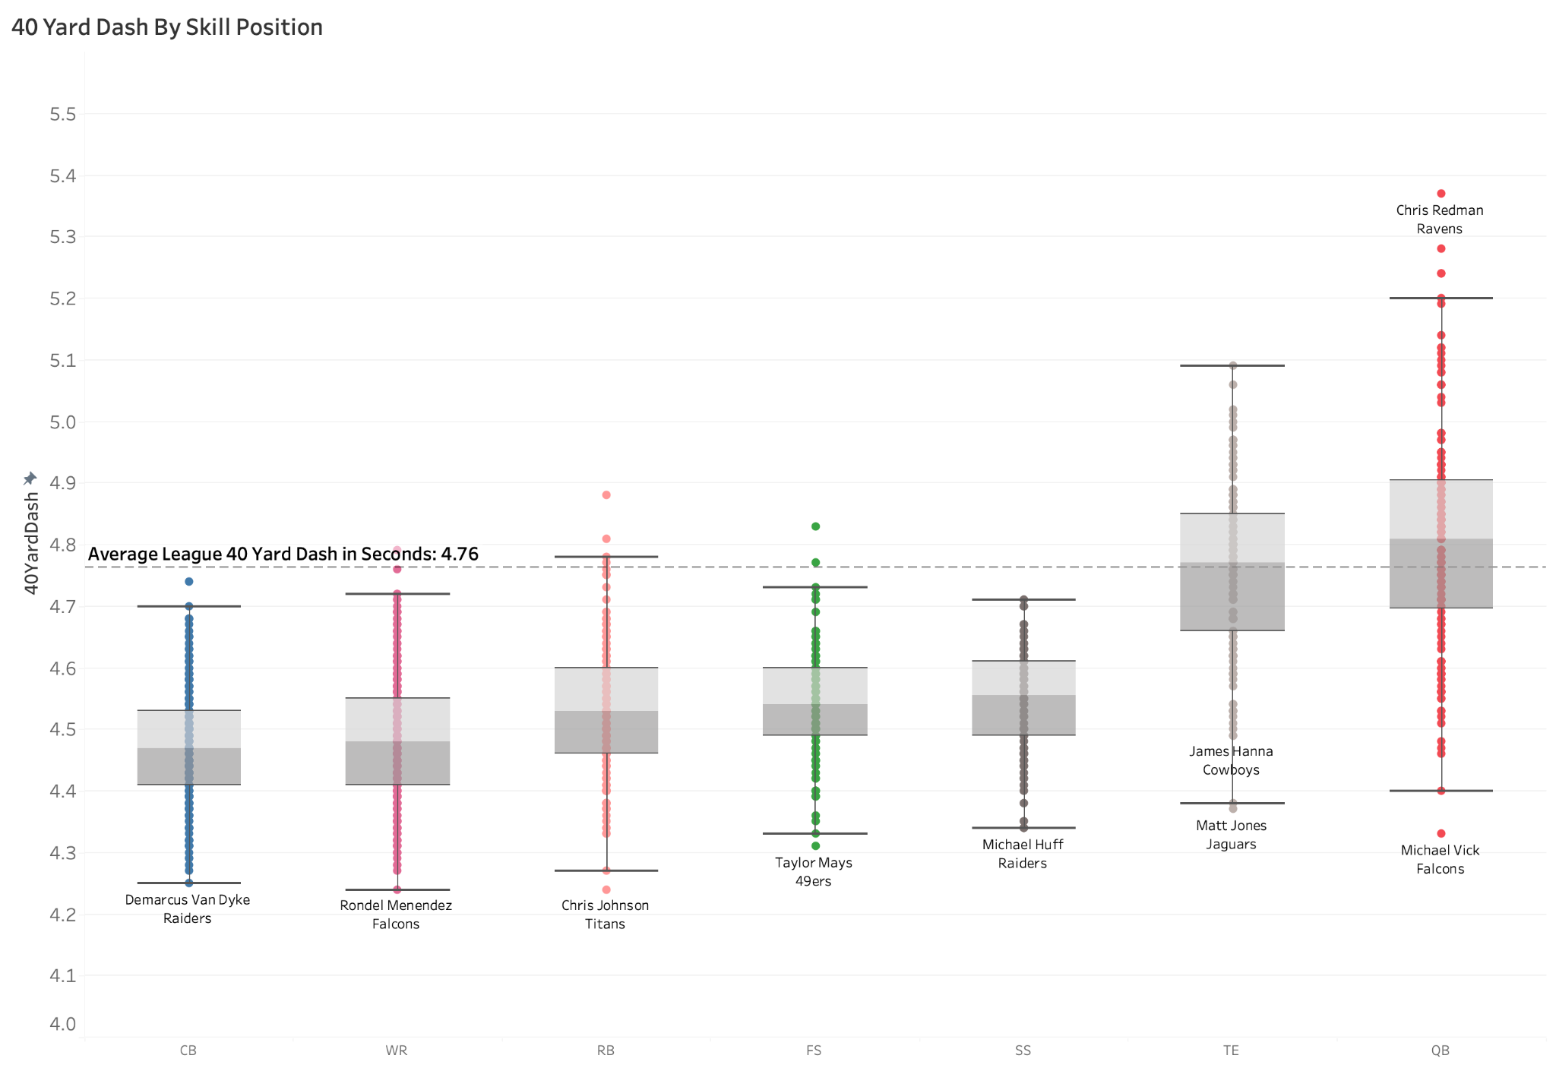
40 - Yard Dash Among Skill Positions
Notes:
Interquartile range is much lower than the average in a stat about speed.
In fact, for the two positions that are meant to be the fastest, the CB and the WR, even there higher statistical outliers are lower or at least at the mean.
Once again with the interquarter range get close to the average of these positions like TE and QB it is because they rely on other athletic abilities.

Slide 11
How Important is the Combine?

Slide 12
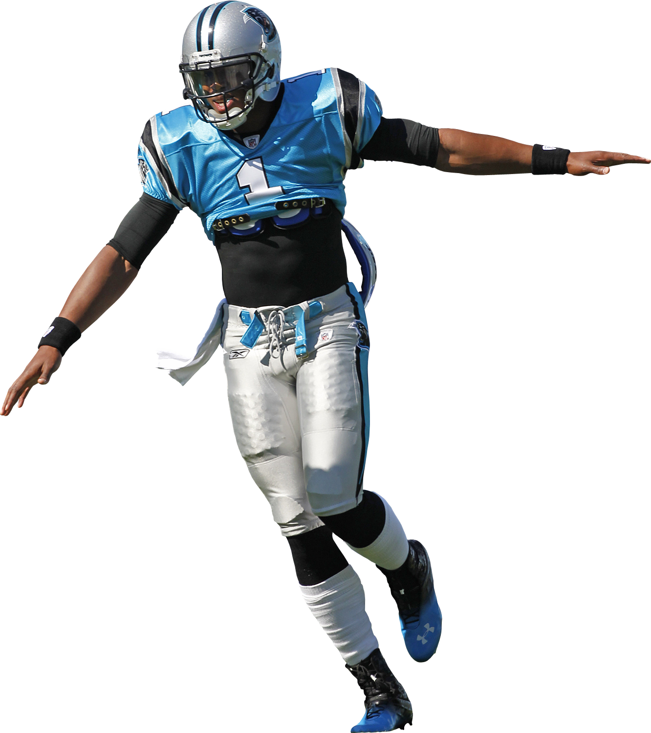
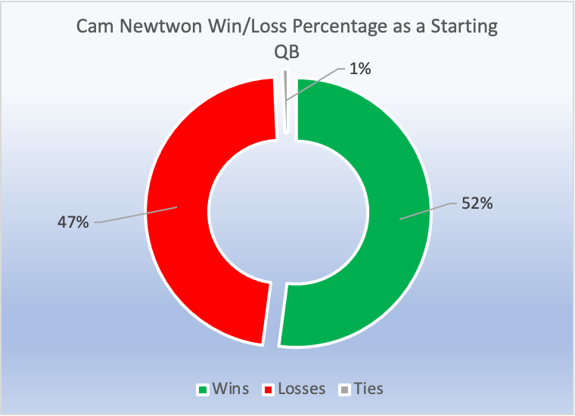
Combine Stud, NFL Gem
Player: Cam Newton
Team: Carolina Panthers
Draft Year: 2011
Round: 1
Pick Overall : 1
Newton had above average combine results for a QB in the 20 Yard Shuttle, the 40 Yard Dash, the Broad Jump, and the Vertical Jump.
In addition, he is above average in height and hand size for a qb.
So far in his 11 Year Career…
3x Pro Bowls
1x MVP
1x ORoY
1x OPoY
144 games as a starting QB

Slide 13
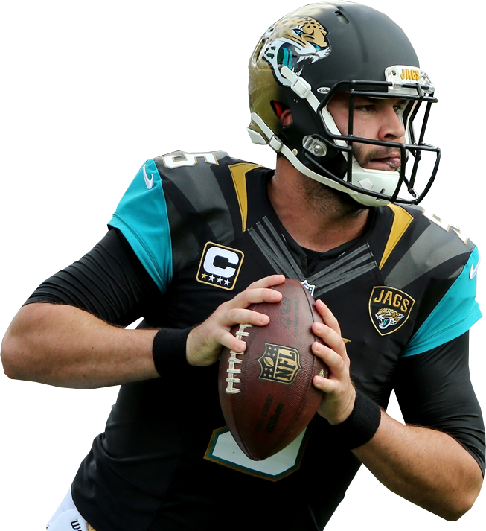
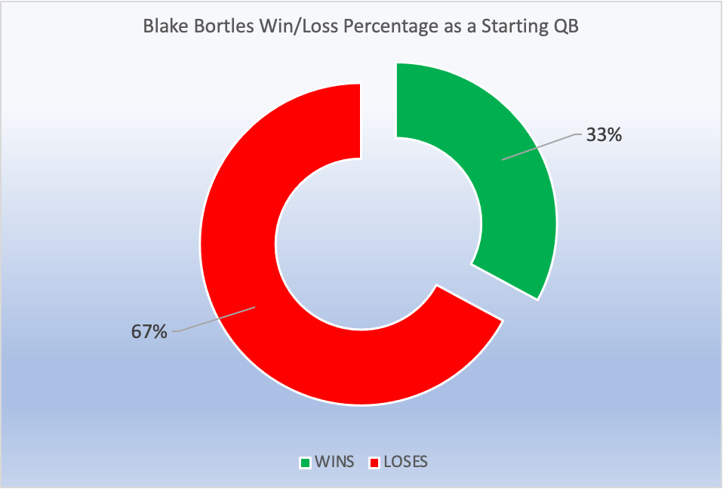
Combine Stud, NFL Bust
Player: Blake Bortles
Team: Jacksonville Jaguars
Draft Year: 2014
Round: 1
Pick Overall: 3
Bortles had above average combine results for a QB in the 20 Yard Shuttle, the Broad Jump, and the Vertical Jump.
In addition, he is above average height for a QB.
73 Games as a Starting QB
Notes:
Above Average Height and Speed
Started 79

Slide 14
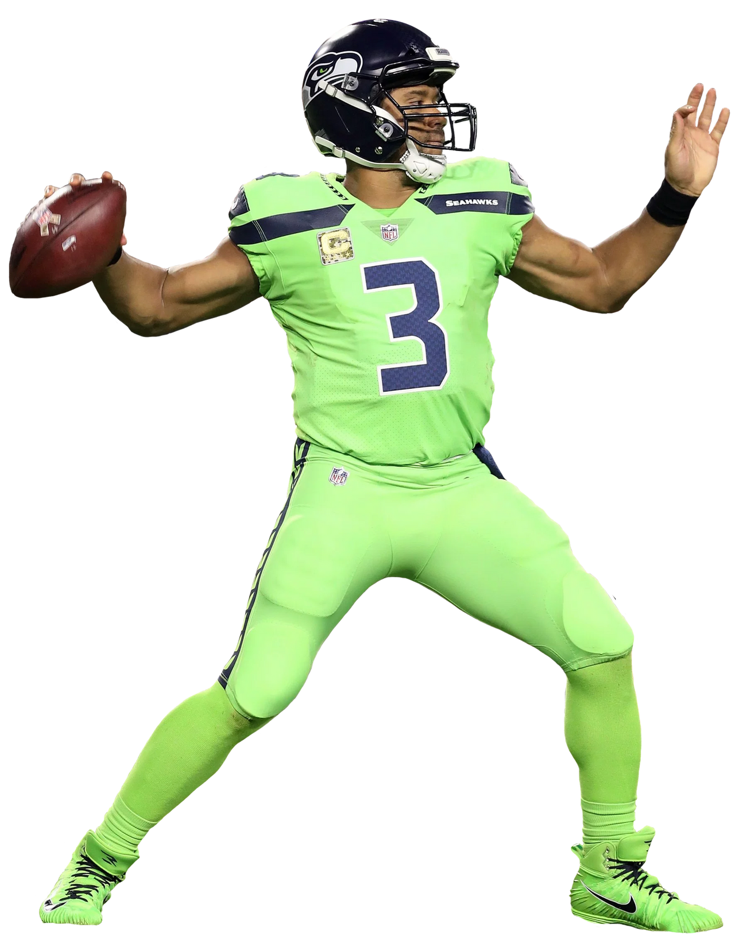
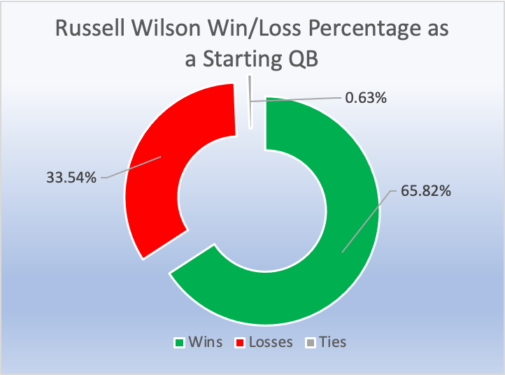
Combine Sleeper: Overlooked Due to Height
Player: Russell Wilson
Team: Seattle Seahawks
Draft Year: 2012
Round: 3
Pick Overall: 75
“You don’t see QBs under 6ft and Russell is a sturdy 5ft 11 (Avg. is 6’3’’)...[H]is height will definitely be a knock.”
NFL SCOUT
So far in his 10 Year Career…
9x Pro Bowls
1x Super Bowl Champion
1x NFL Passing Rating Leader
1x NFL Passing Touchdown Leader
158 Games as a Starting QB
Notes:
Russell Wilson had above average combine results and pre - draft measurements in every single category except for height.
This is one of the main reason he fell out of the first round.

Slide 15
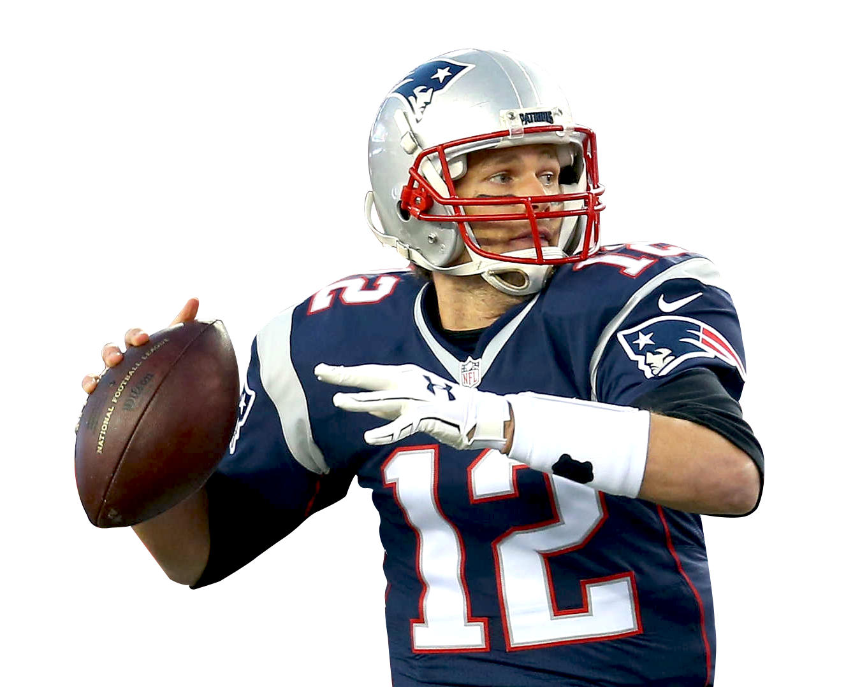
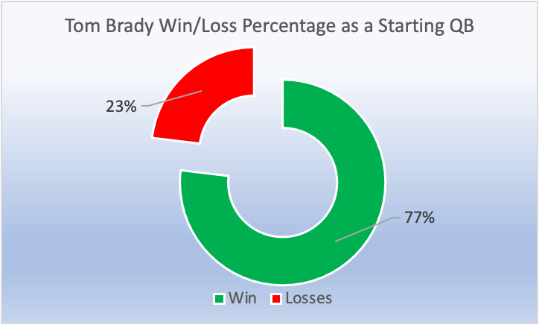
Combine Sleeper:
Overlooked Due to Athleticism
Player: Tom Brady
Team: New England Patriots
Draft Year: 2000
Round: 6
Pick Overall: 199
So far in his 23 Year Career…
7x Super Bowl Champion
5x Super Bowl MVP
3x NFL League MVP
…Often Considered the G.O.A.T
“There were 15 offensive lineman at that combine that both ran faster and jumped higher than Brady…”
“He’ll make somebody a good husband or a good medical salesman.”
NFL SCOUT
316 Games as a Starting QB
Notes:
Below Average in Most Categories except for height.
40 yard Dash - 5.3,
Vertical Jump 24.

Slide 16
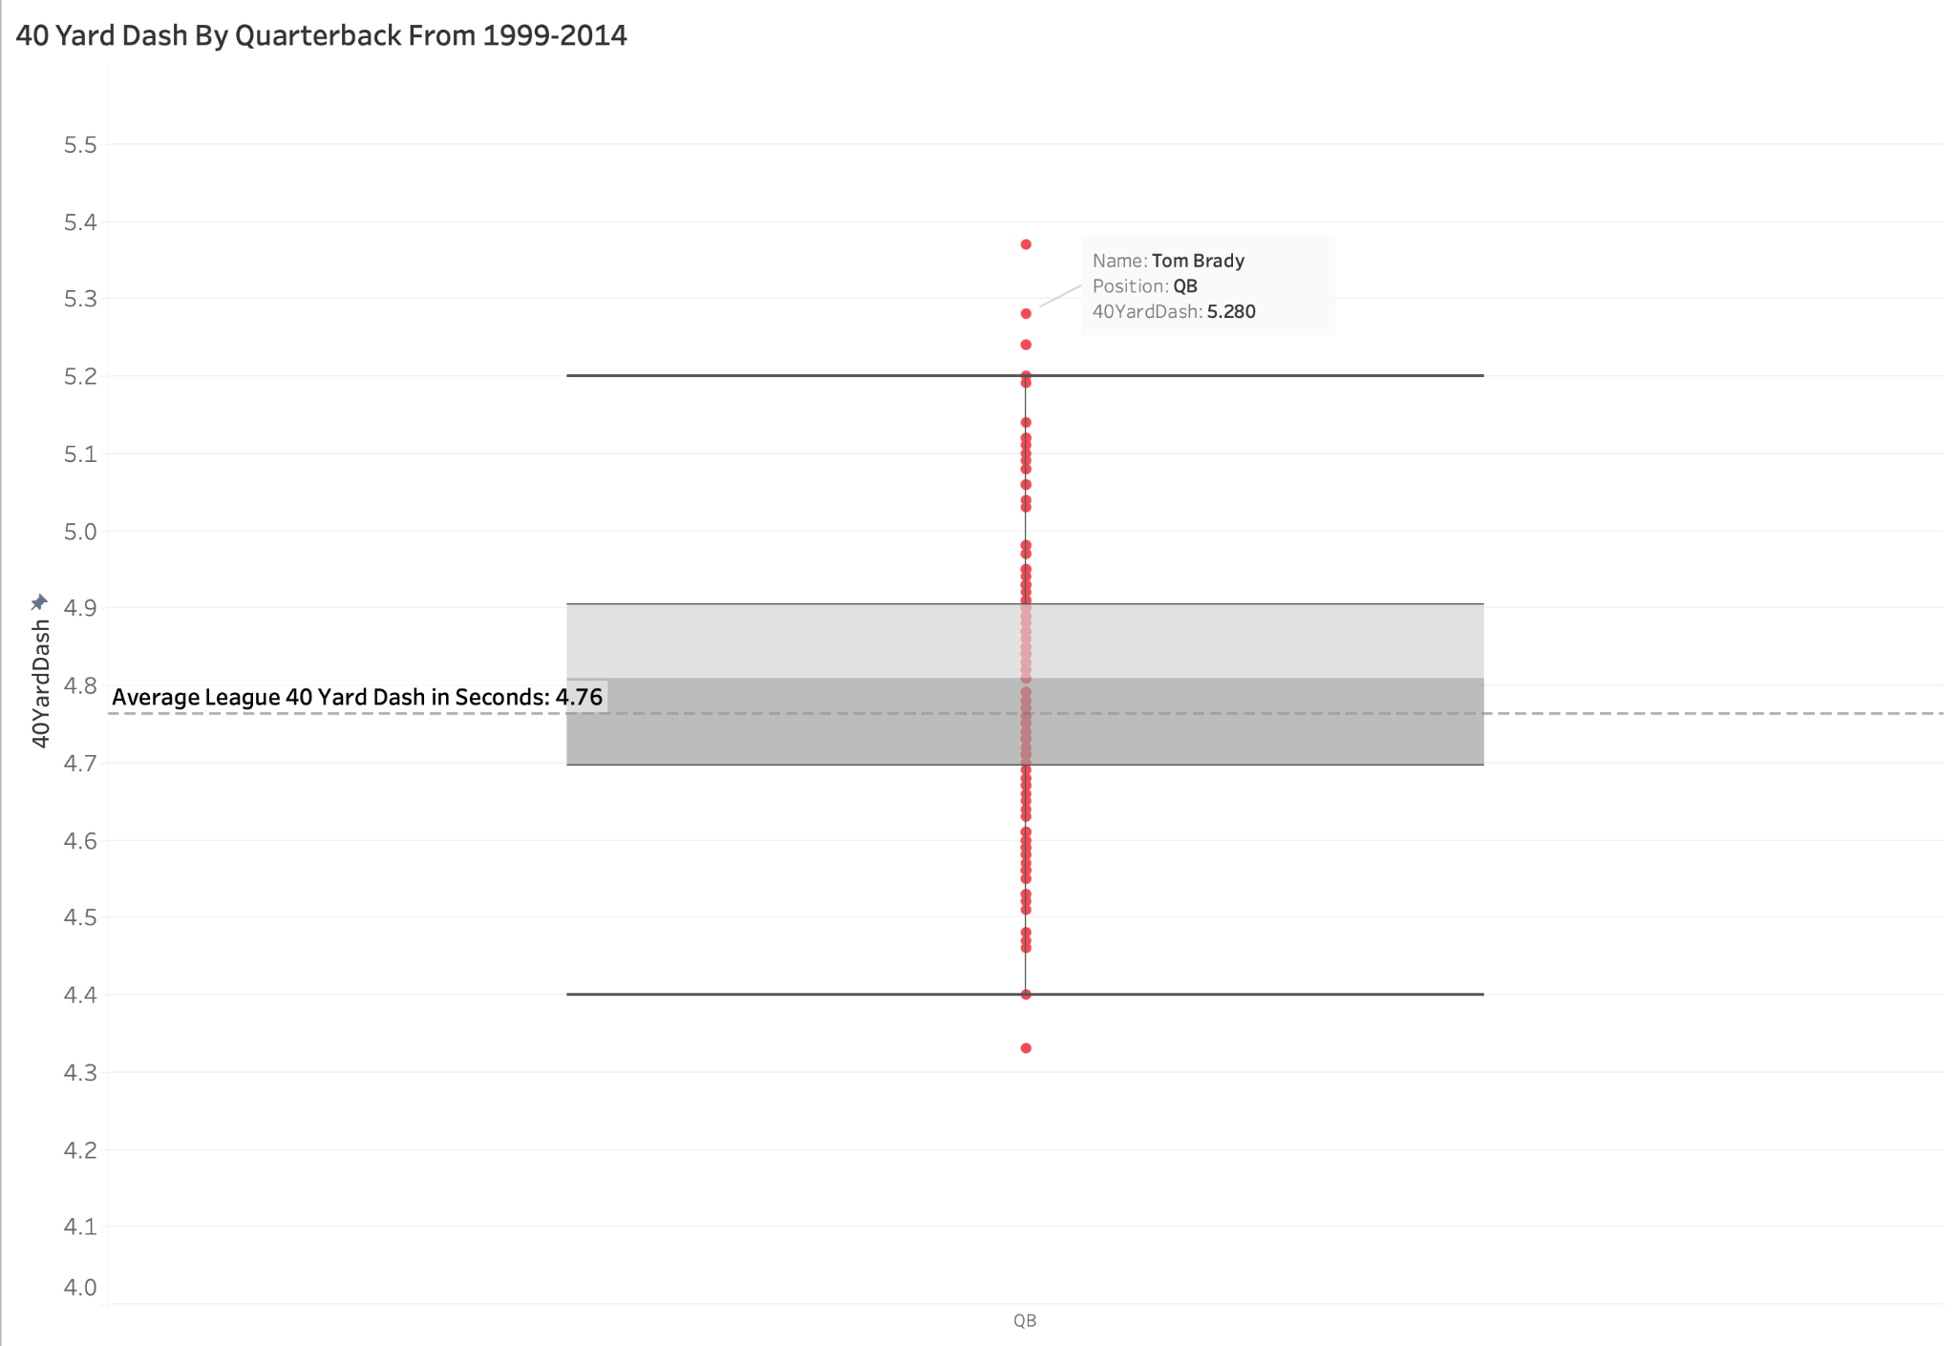

Slide 17
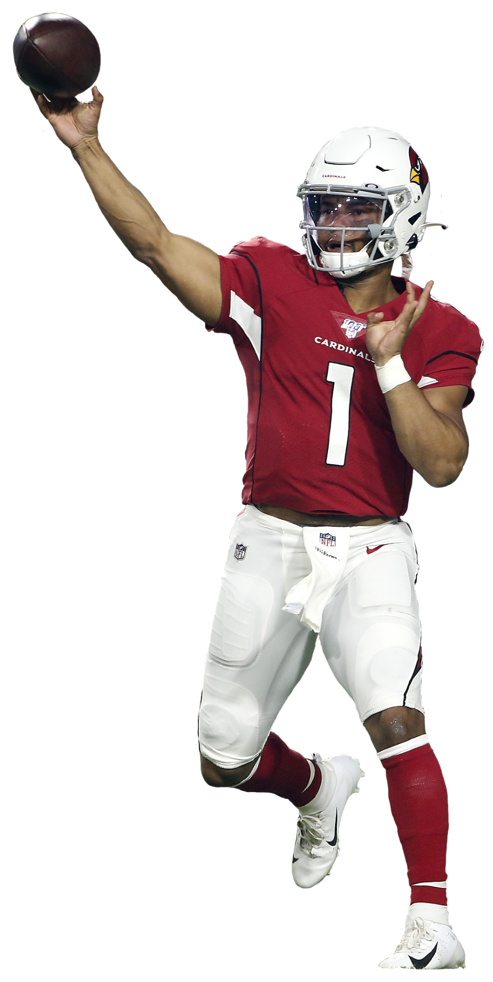
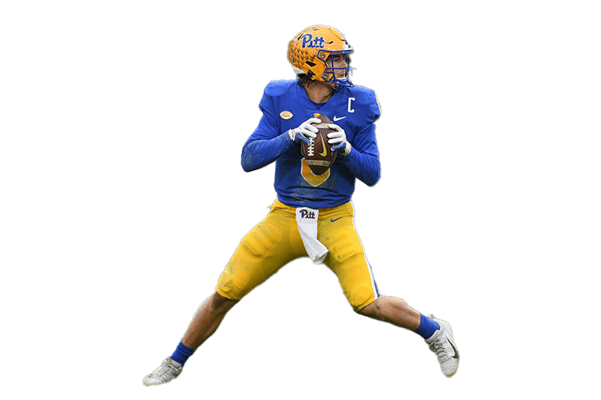
Conclusion
Notes:
-Kyler Murray and Kenny Pickett Drafted high
-Kyler Murray stands at 5’10
-Kenny Pickett hand hands that were too small.
- The Combine is pretty solid at measuring the baseline requirements to be NFL player, although there will be some outliers
-For every overlooked super star you have 100s of players who aren’t any good.

